Slide 1
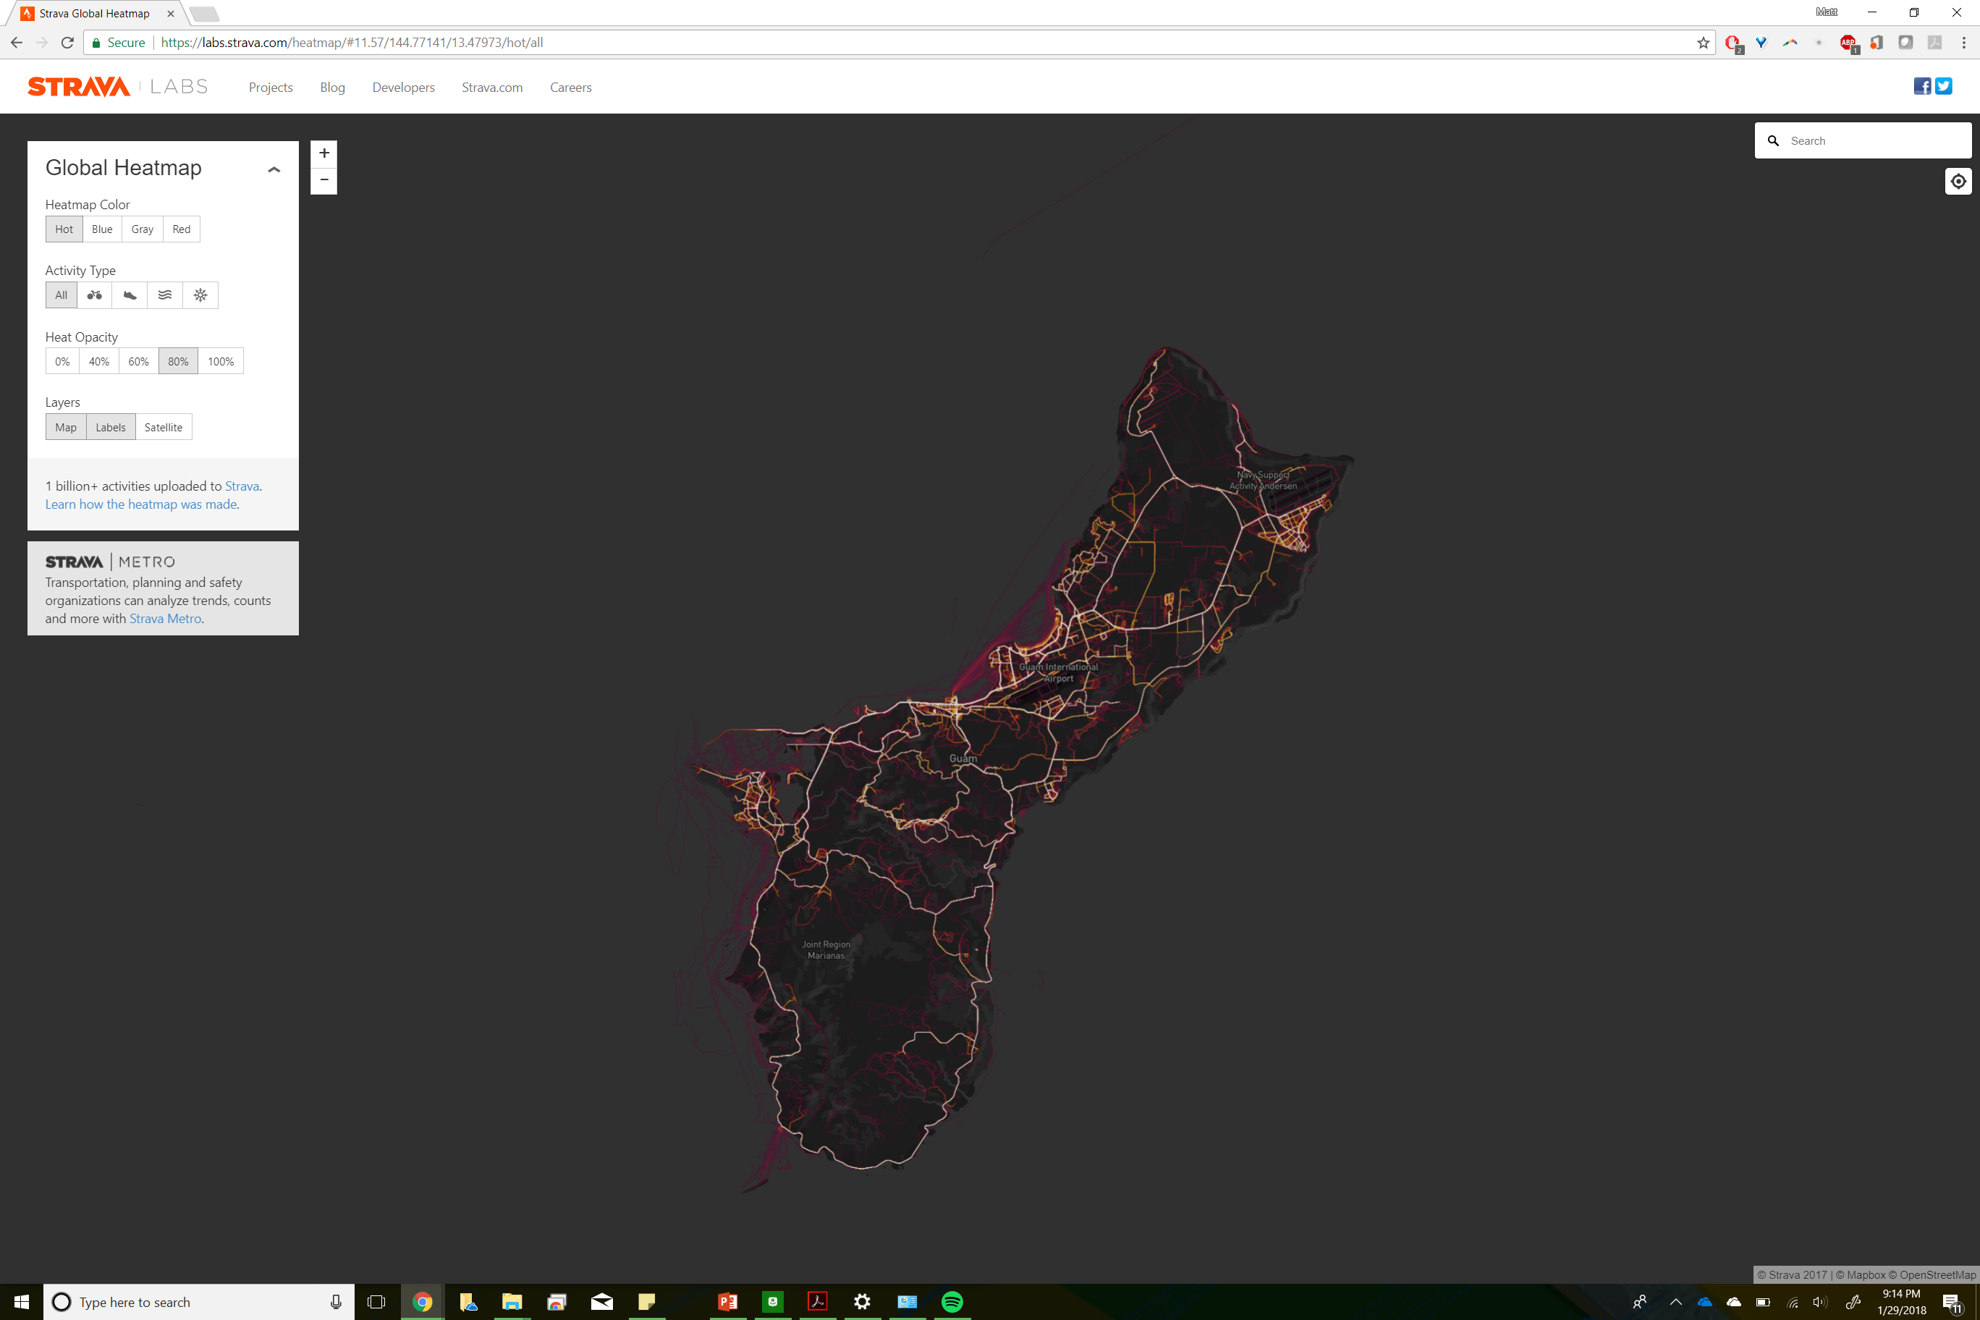
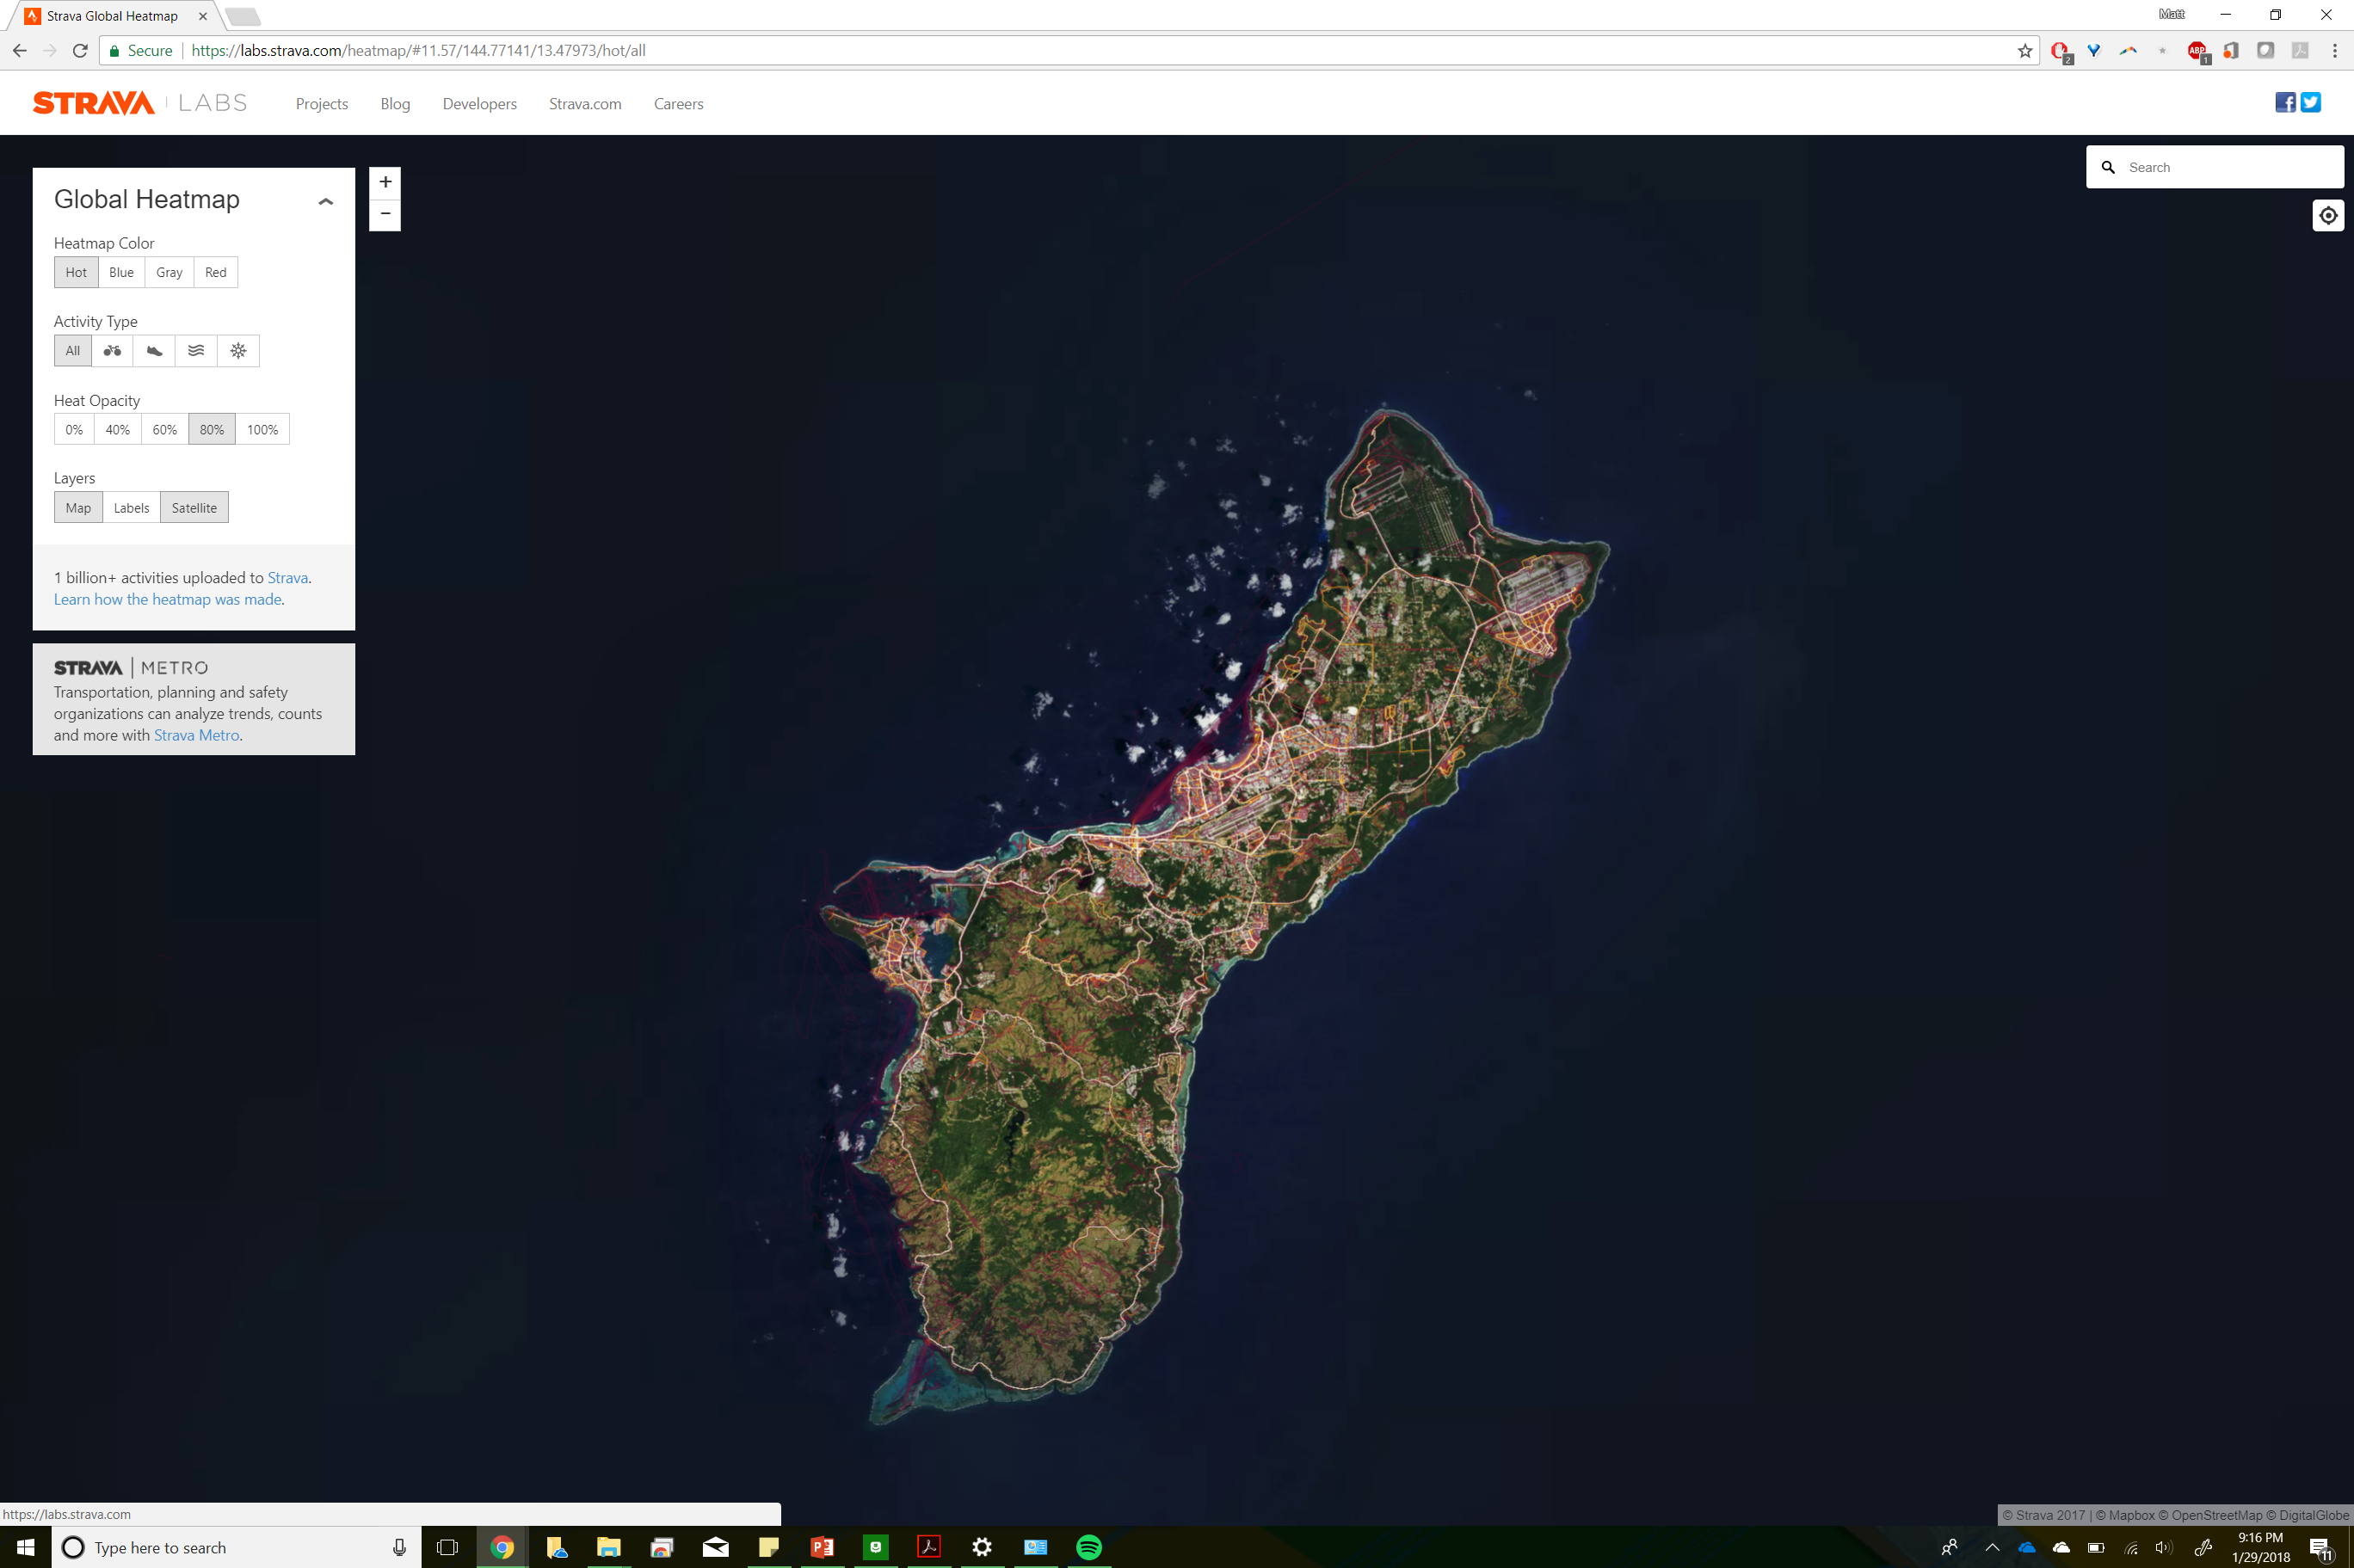

Slide 2
Plan for this week
Tuesday:
The Raster Data Model
Thursday:
Map Algebra
Local operations

Slide 3
What is spatial analysis
Goes beyond maps and mapping
Visualization is at the most basic end
Link data to location
Identifying data based on a location
Explore the relationship between data (variables)
Extend that into the realms of explanation and prediction
Data has to be linked by ID/OID/FID, space-time, and include some attribute
Not necessary to have the same location/time
Surface flow through a watershed
Precipitation amounts through time
Spending locations across a city

Slide 4
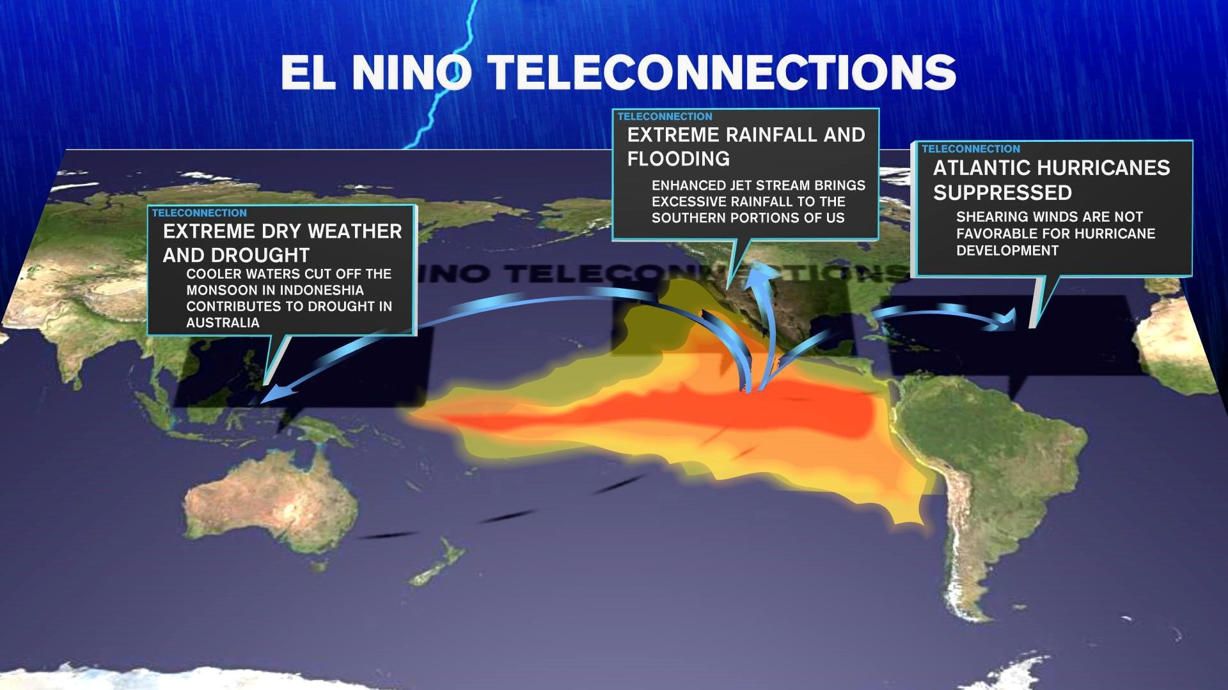
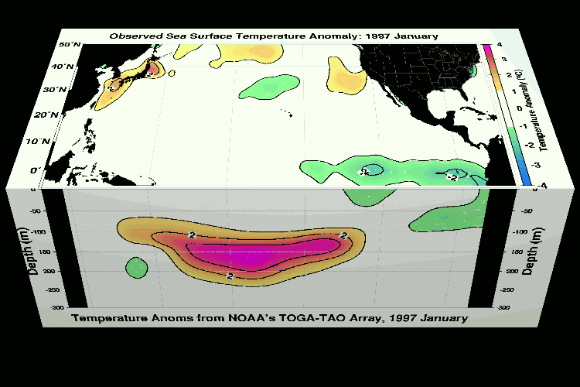
How can Spatial Analysis Help
Deriving Spatial relationships (finding the links)
Sometimes called “Teleconnections” in literature
ENSO cycles
Reveal spatial relationships that might otherwise be “invisible”
Make explicit what is implicit
Spatial connectivity
Groundwater flow from one basin to another
DEM analysis
Watershed, terrain shadow, viewsheds
Spatial correlation and auto-correlation
Continuum of sophistication
Mapping -> Queries -> Complex statistical methods (interpolation, PCA)
Notes:
La Niña is the positive or cold phase of the Pacific. When this occurs, sea surface temperatures, from near the South American coast westward into the equatorial Pacific, will drop below normal, while abnormally high air pressure keeps the atmosphere stable. Southern California will typically see below-normal rainfall during La Niña phases. In fact, a large chunk of our current four-year drought played out during a La Niña event. Meanwhile, the western Pacific experiences abnormally low air pressure and stormy weather.
The negative or warm phase of the Pacific is called El Niño. During El Niño, the equatorial sea surface temperatures across the eastern Pacific, particularly off the South American coast, climb well above average. Abnormally low pressure dominates the eastern Pacific while abnormally high pressure is in place across Indonesia. For Southern California, strong El Niño phases generally produce above normal rainfall.
http://ktla.com/2015/10/14/el-nino-2015-defining-el-nino/

Slide 5
What Questions/Phenomenon
Effective analysis are “tailor made” for certain problems
Cellphone tower siting
Methods were originally made for applications
Retooled for generalized application
Essential to identify and understand a domain
Know the domain
Know what you are looking for
Apply findings to analysis
I’m biased towards the physical systems

Slide 6
Raster or Vector?
 | Raster | Vector
Definitions | Gridded data, spatially associated with itself Larger files Best represents a continuum Simple data structure | Geometrically and mathematically associated Points, lines, polygons Single & Multipart
Tradeoffs | Overlay analyses are easily and efficient HPC friendly High variability more efficiently represented How screens work | More compact data structure Smaller files More “accurate” More amenable to network analysis Visually appealing
Raster's tell us where things are everywhere and vector tells us where everything is

Slide 7
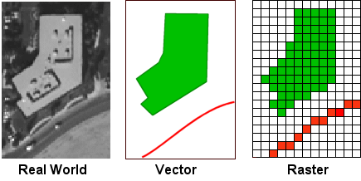
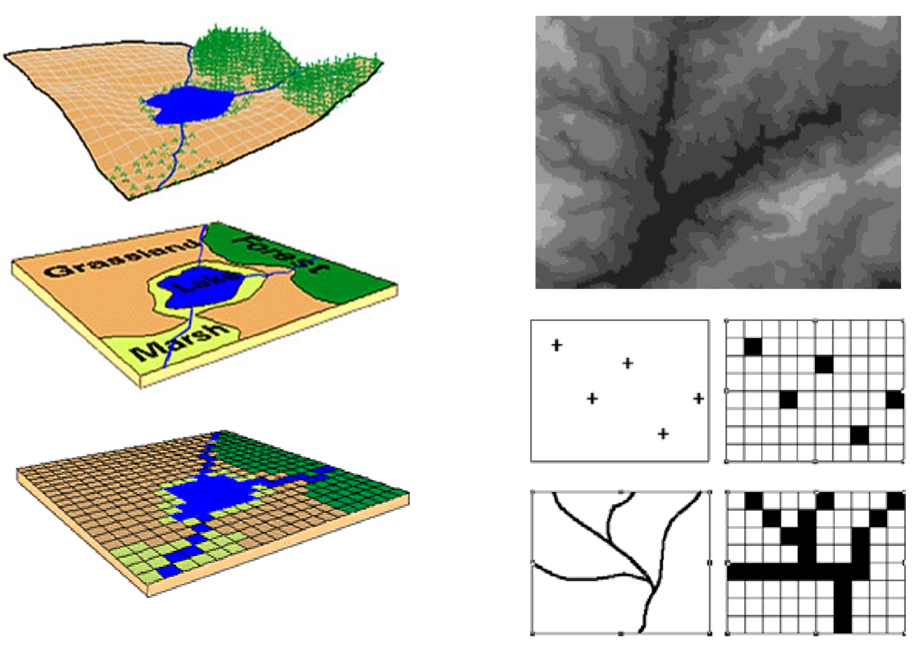
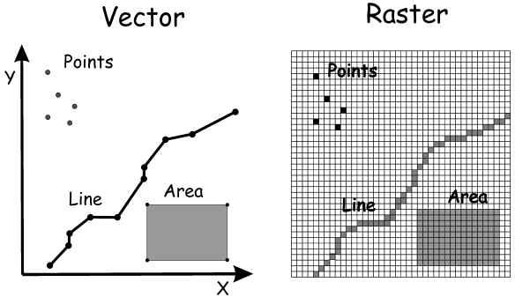
The Raster Data Model

Slide 8
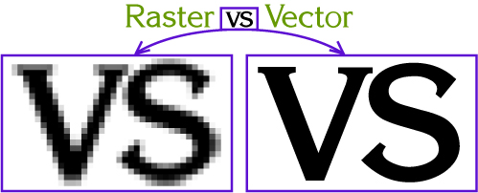
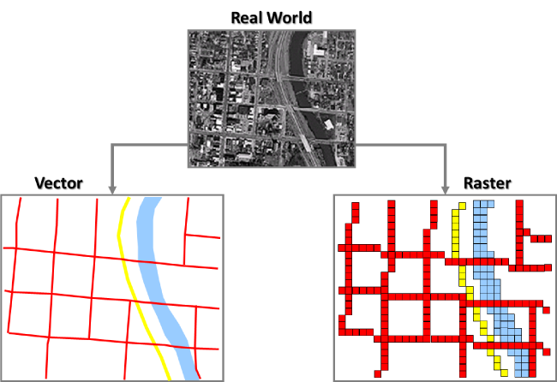
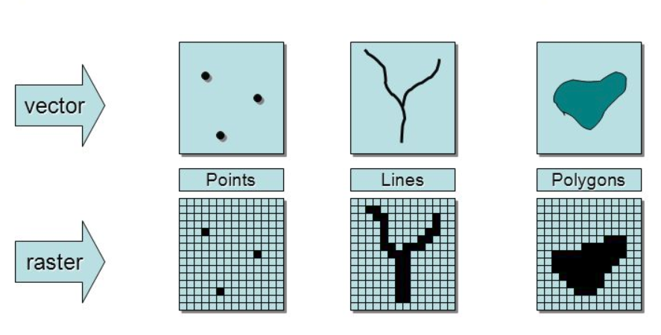

Slide 9
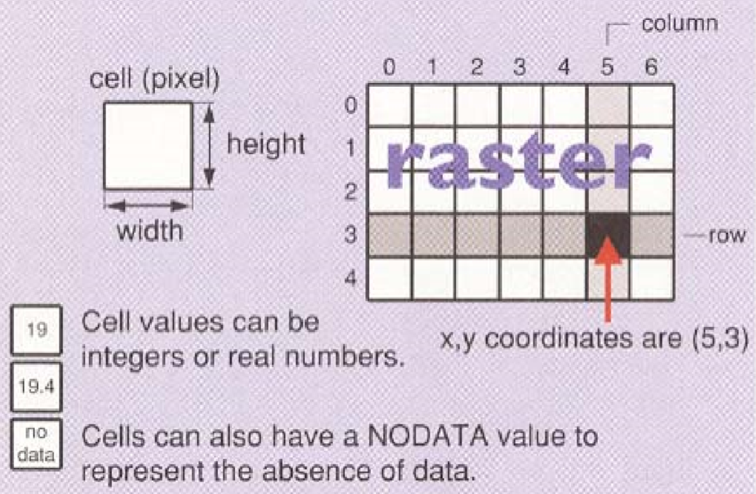
Raster Datasets
A matrix of numbers
Cell value statistics
Storage
2D array vs run-length encoding
Very large raster's
Multiple resolutions
Computer Formats
What makes a raster different from and image?
Spatial reference
Explicit cell size and spatial extent

Slide 10
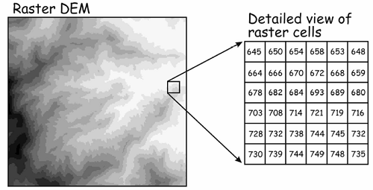

Slide 11
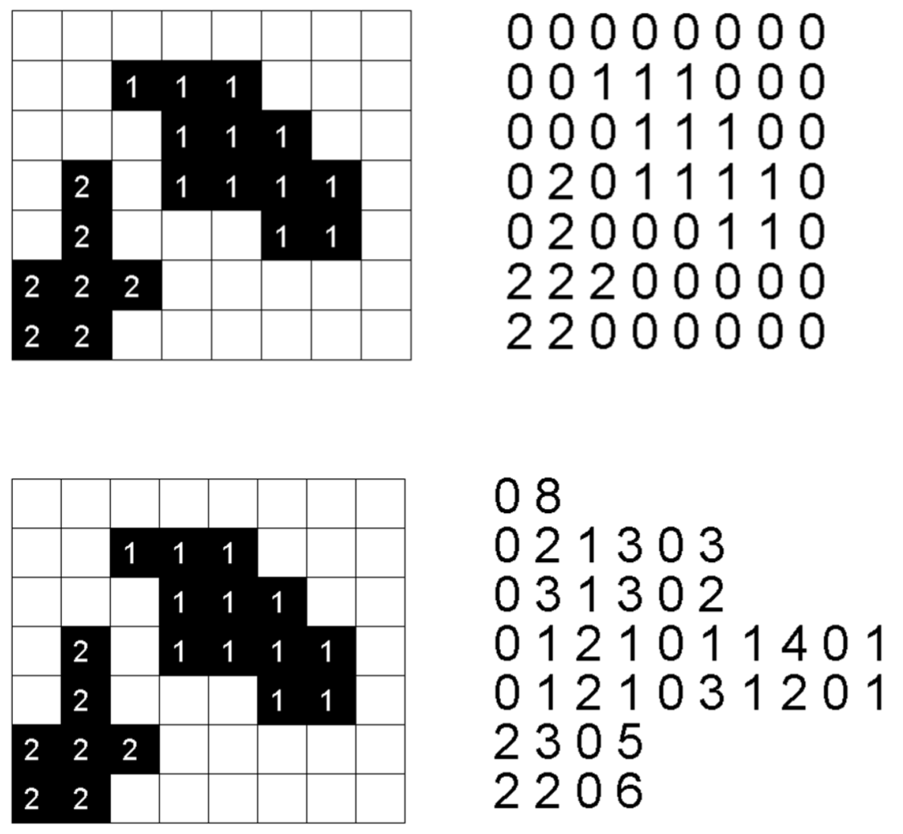
Storing Cell Values
2D array
Stored cell by cell as a 2D array
Run Length Encoding
Stored as a list of (value) (occurrence)
Does run length encoding guarantee compression?

Slide 12
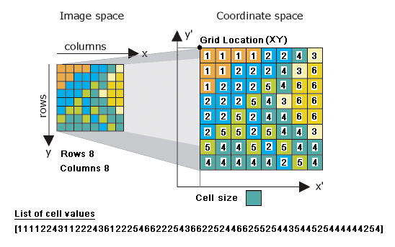
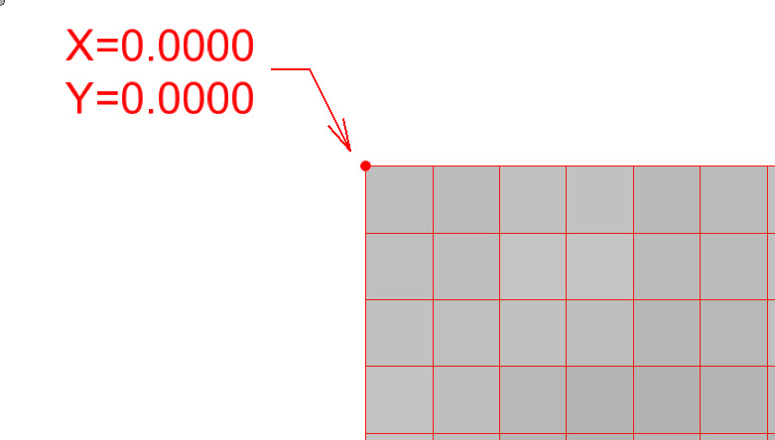

Slide 13
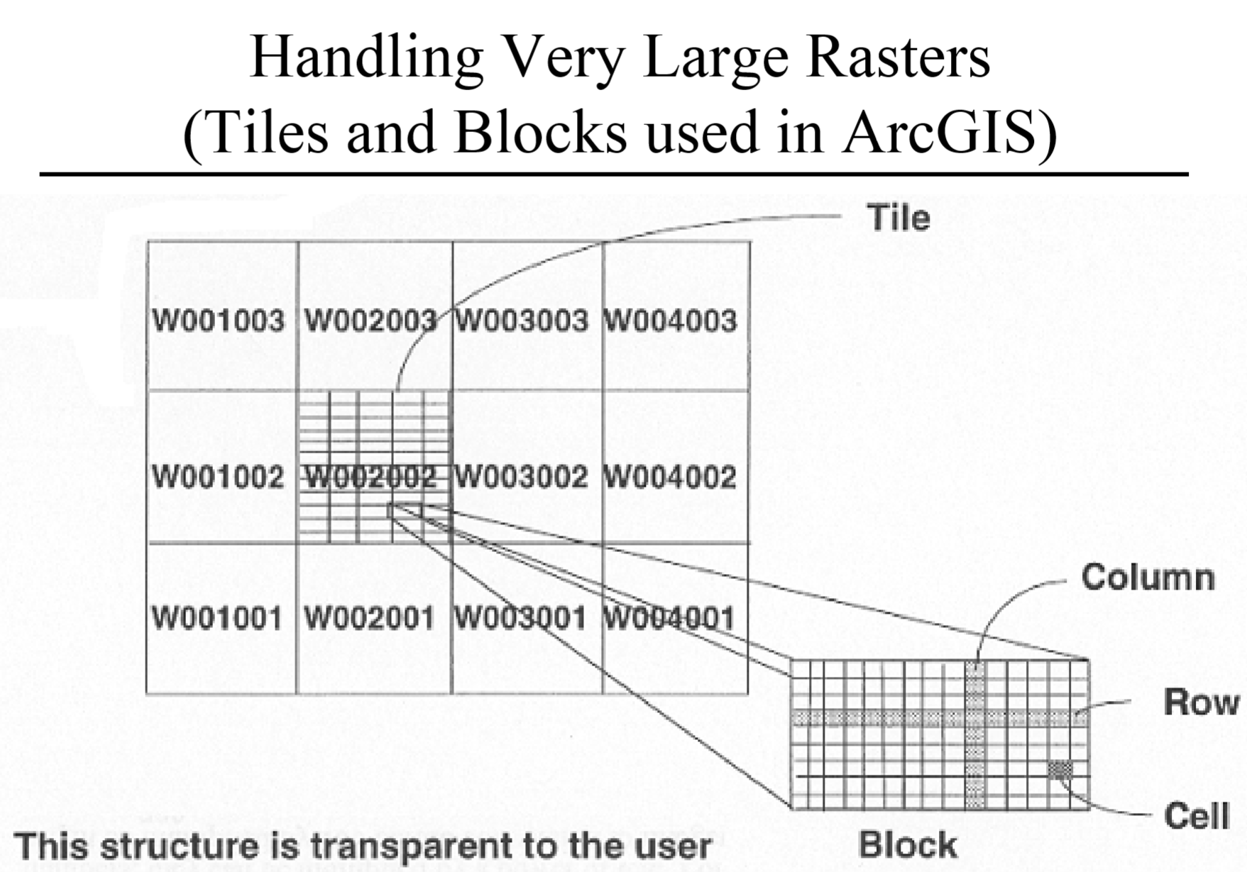
Disk based storage
Does not have to all be in memory ay once
Parallelization analysis

Slide 14
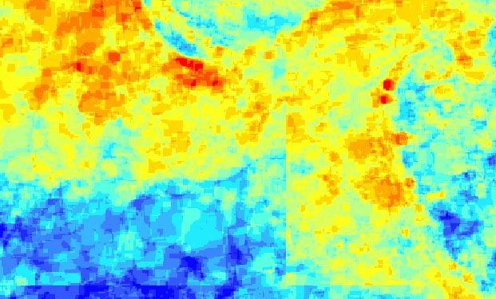

Slide 15
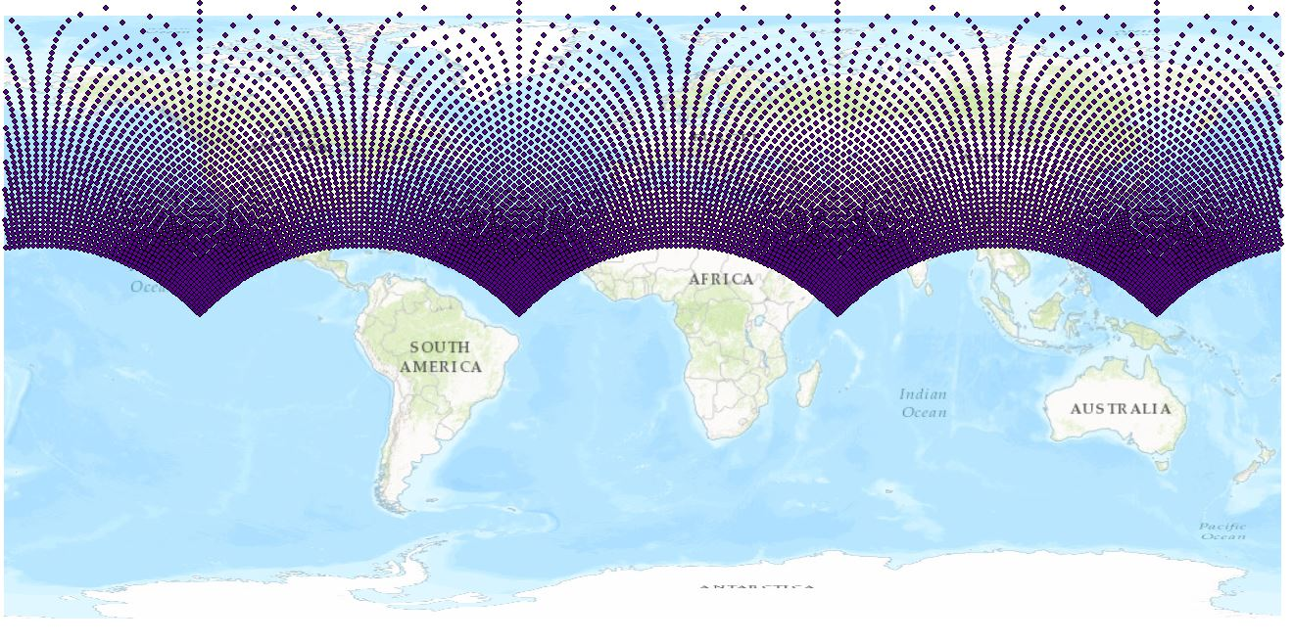

Slide 16
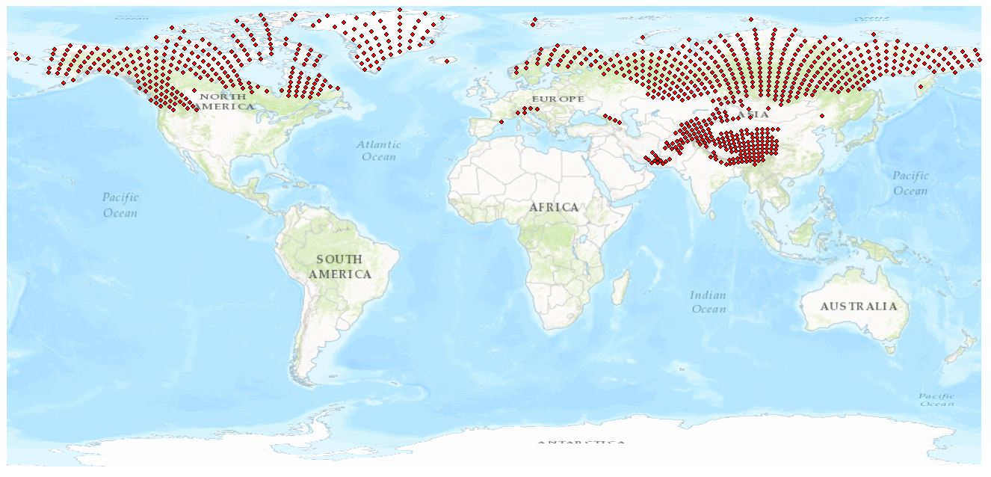

Slide 17
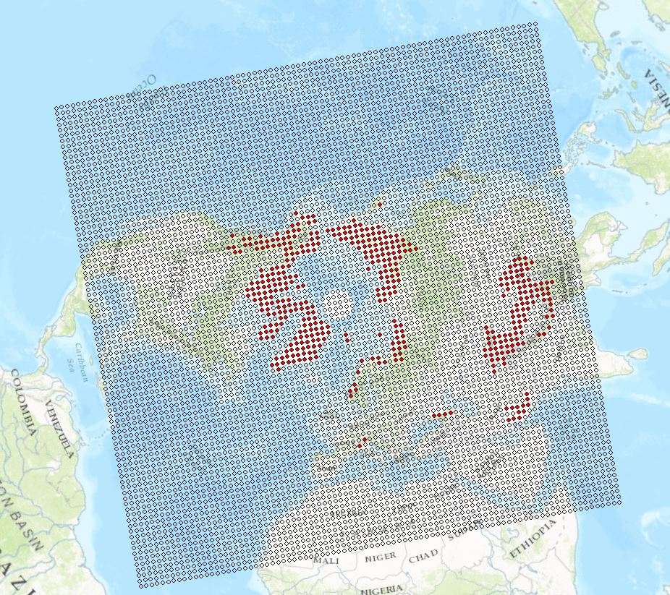

Slide 18

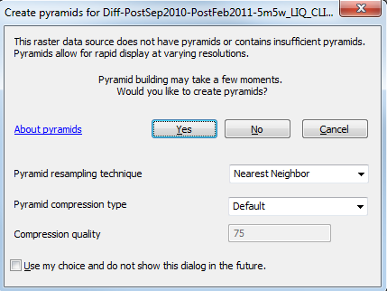
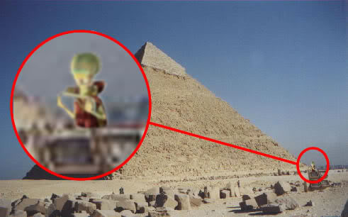
Why Tile?

Slide 19
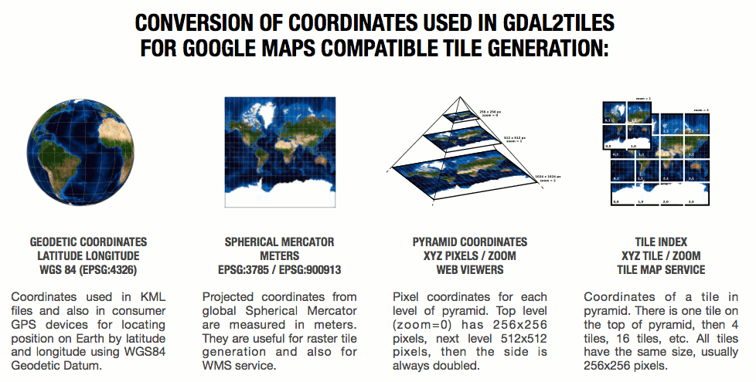
Tiling

Slide 20
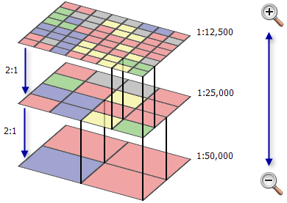
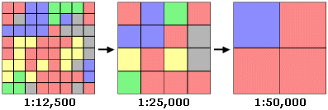
Why Tile?
Notes:
Build pyramids? Yes.

Slide 21
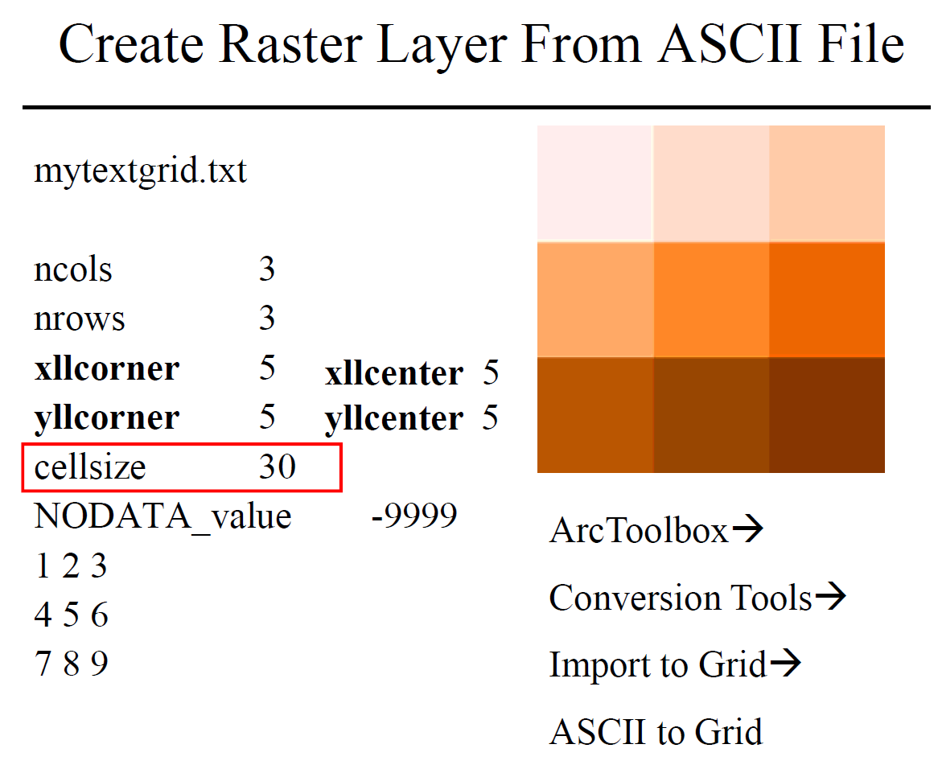
Raster Formats
Tiff
Geotiff
.tfw
JPG
Jpg2000
.jpw
netCDF*
ASCII

Slide 22
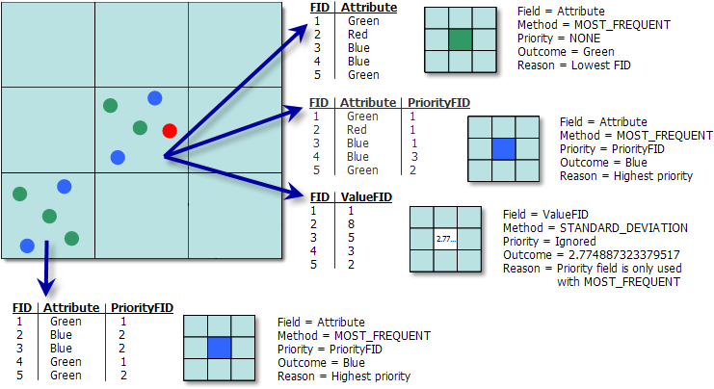

Slide 23
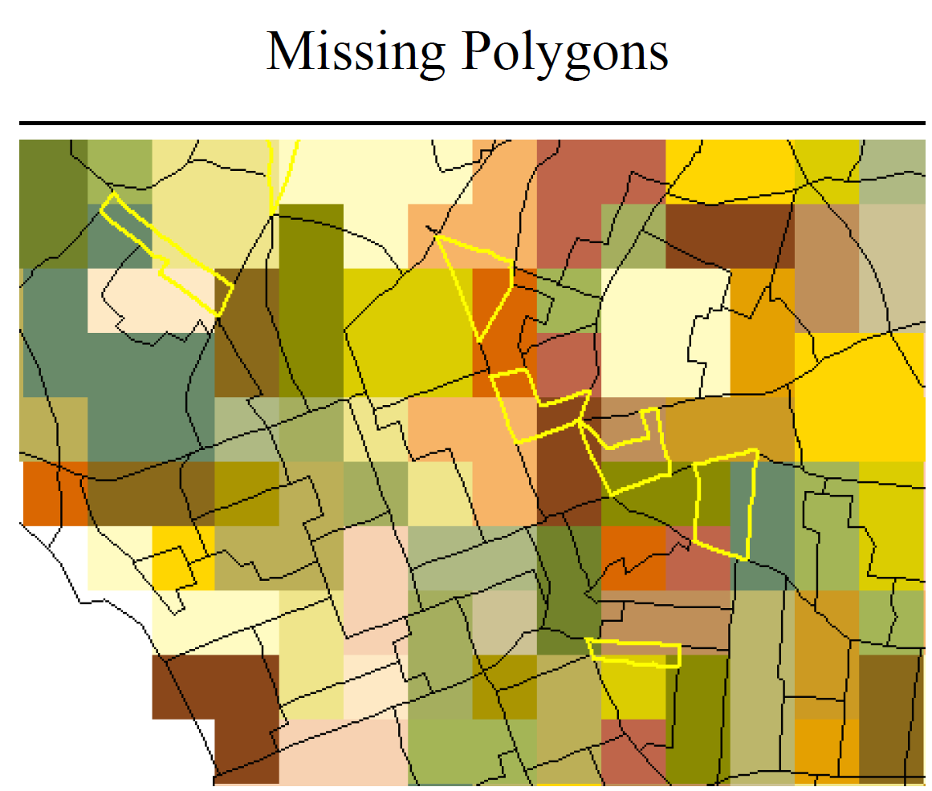
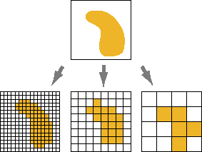

Slide 24
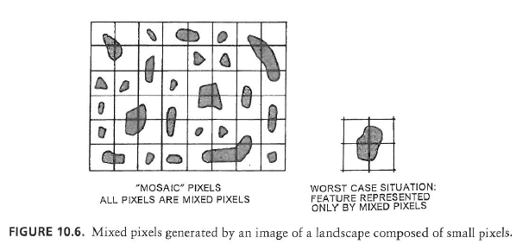
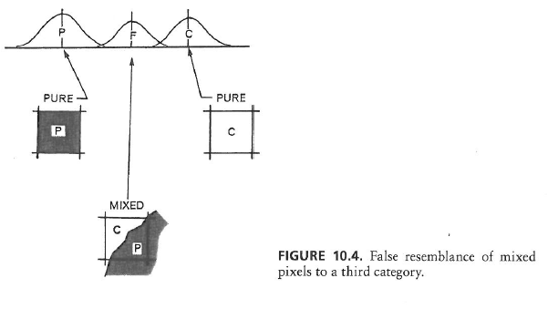
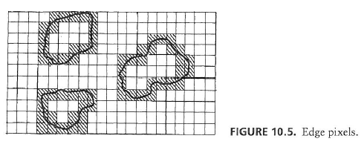
Mixed Pixels

Slide 25
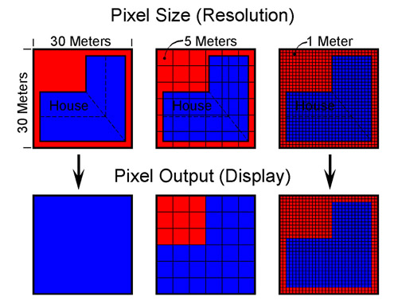
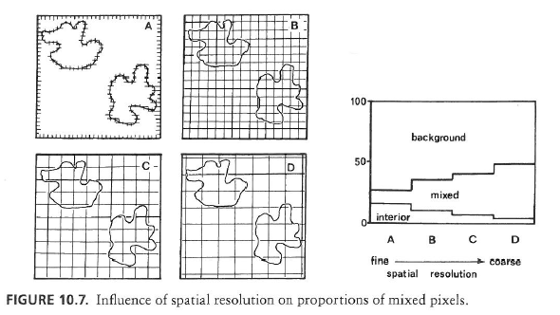
Spatial Resolution and Mixels

Slide 26
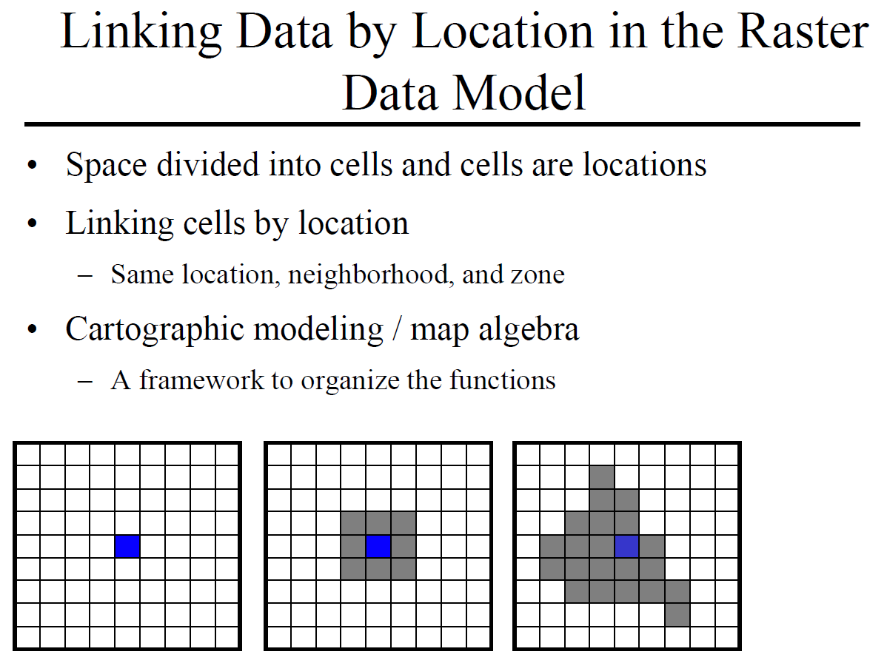

Slide 27
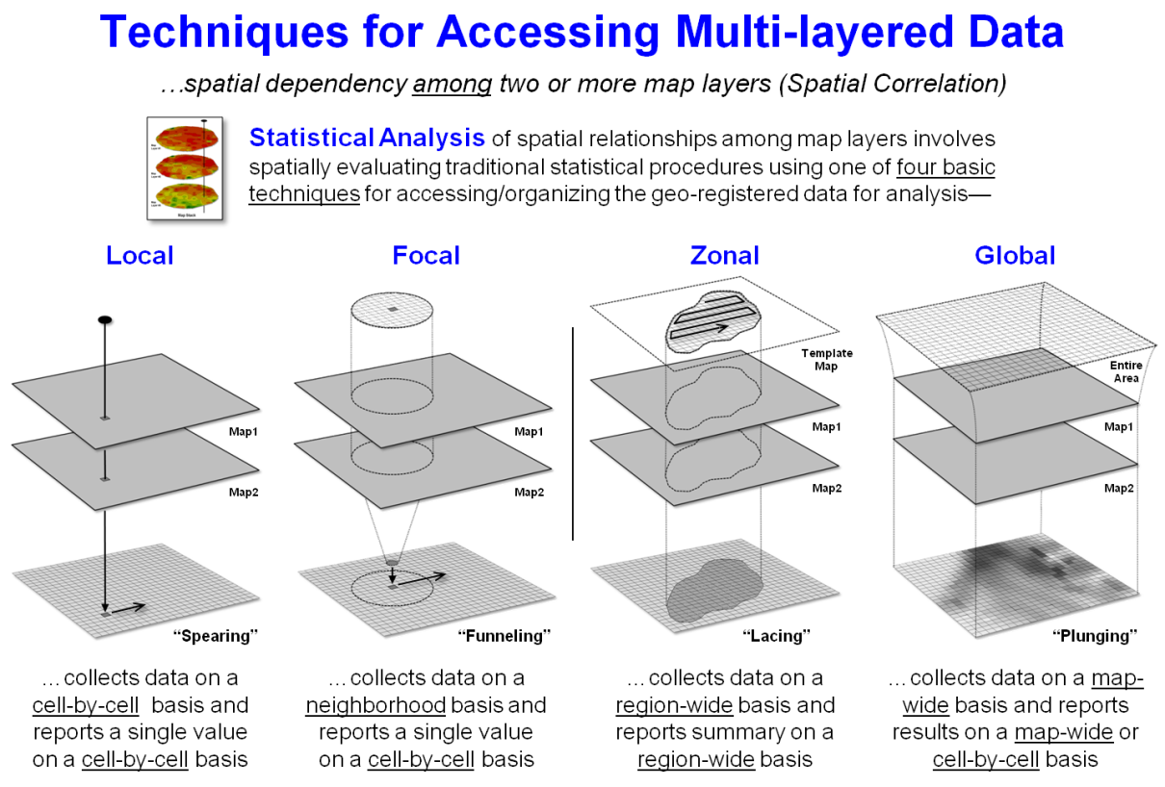

Slide 28
Remote Sensing Concepts
Resolution
Radiometric
Spectral
Spatial
Temporal
Discrete vs. Continuous measurements
Electromagnetic Radiation and Spectral Signatures

Slide 29
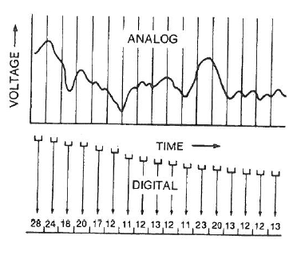
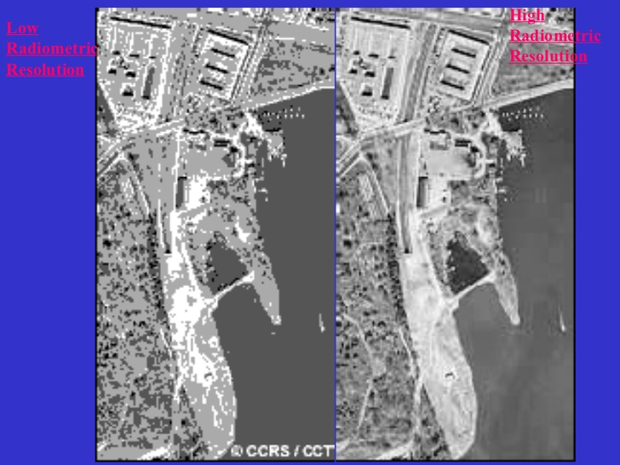
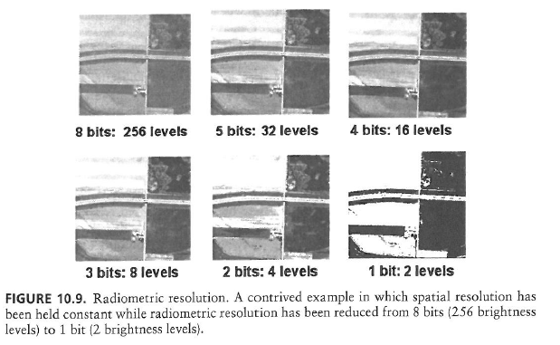
Radiometric Resolution
Number of brightness levels that can be detected by the sensor
Also known as radiometric sensitivity, quantization, or simply the number of bits per pixel

Slide 30
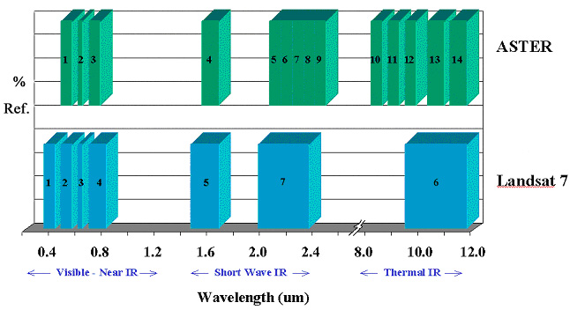
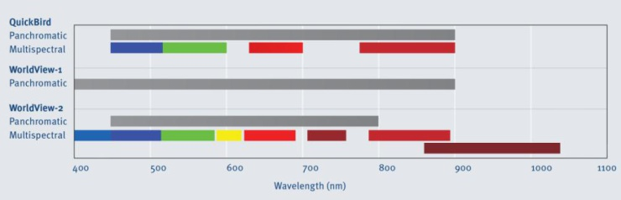
Spectral Resolution
Number of bands on the sensor
Bandwidth
Band location on the spectrum

Slide 31
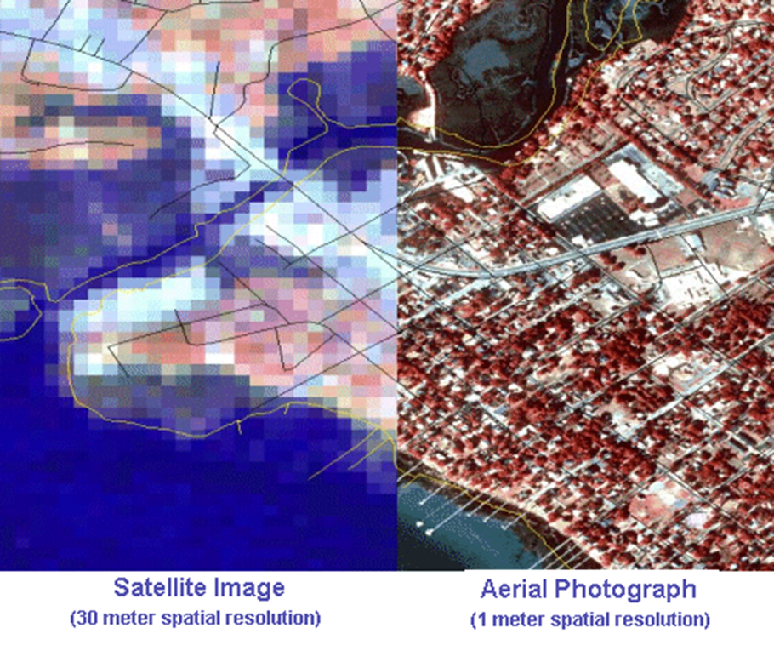
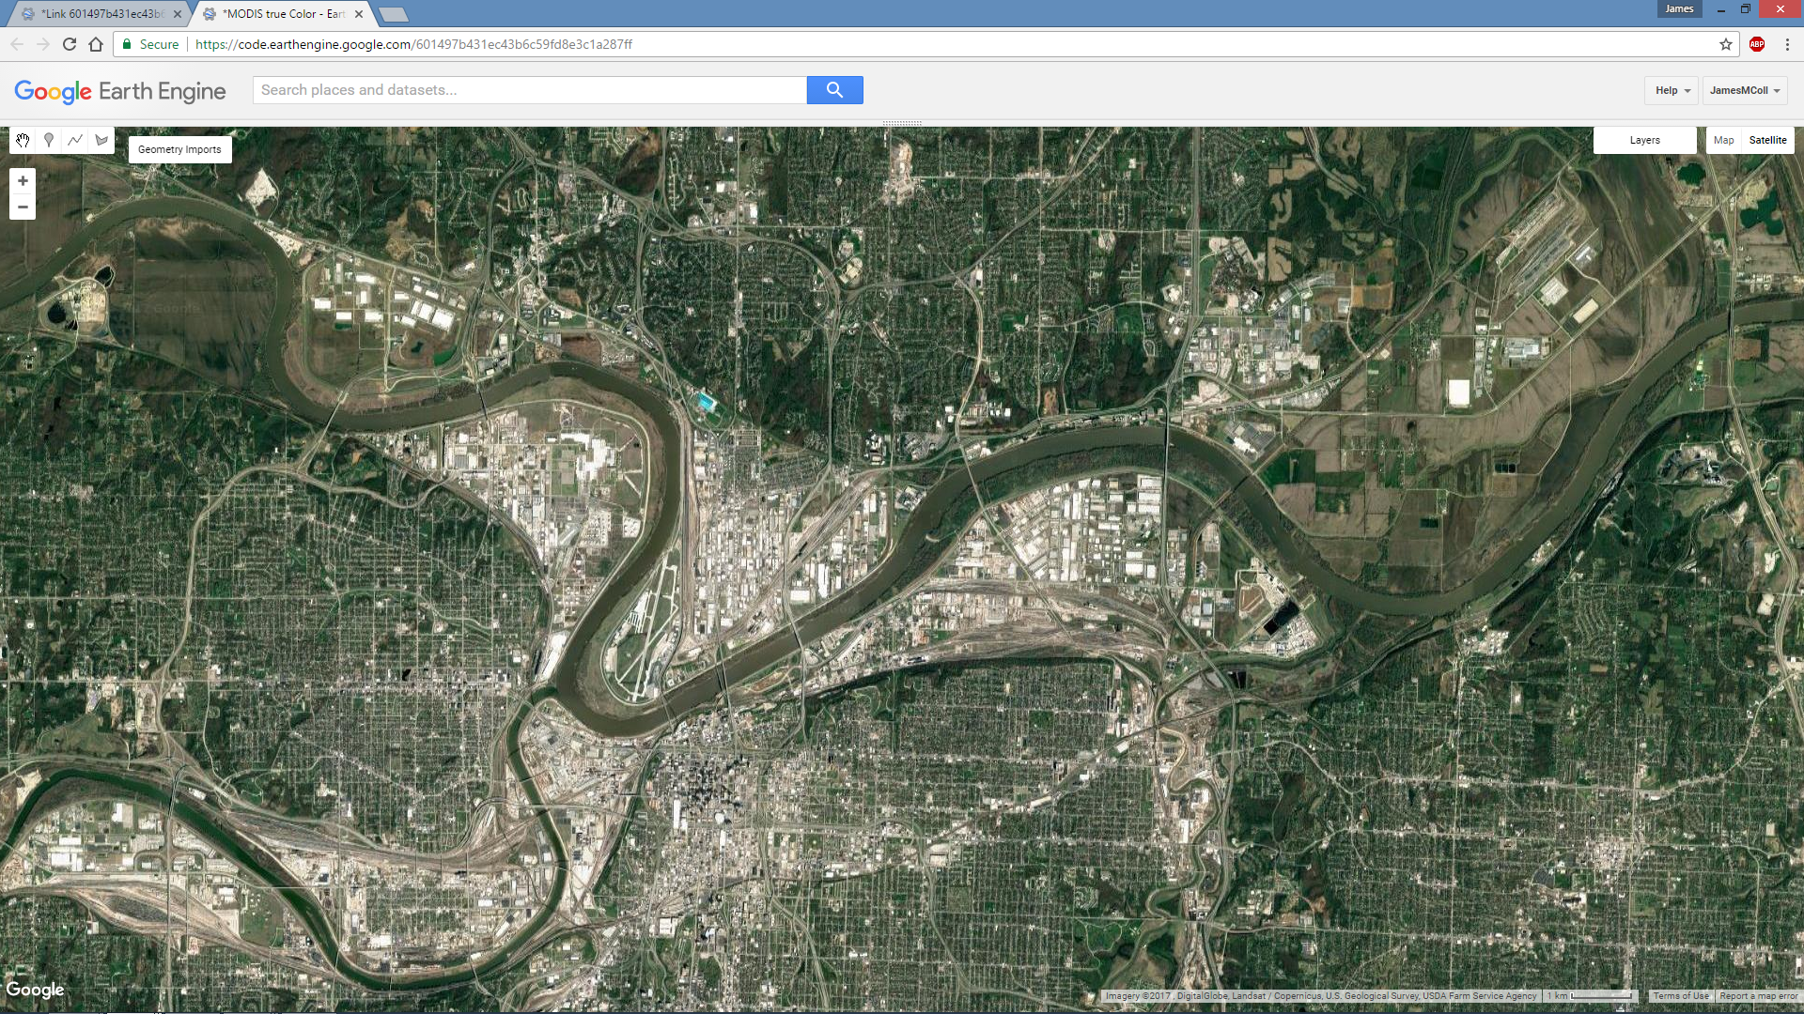
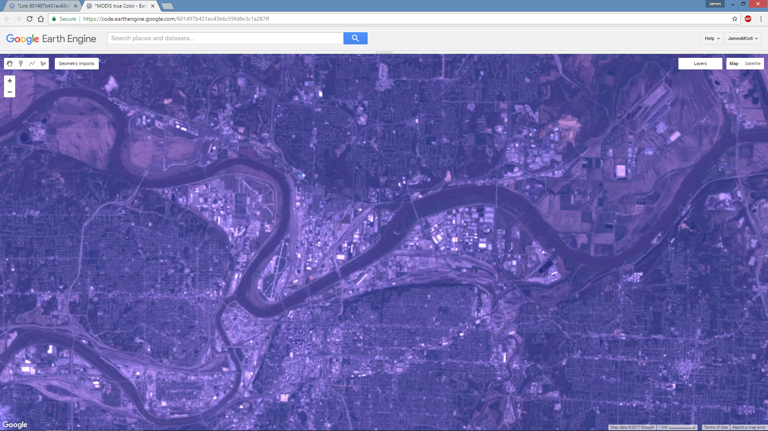
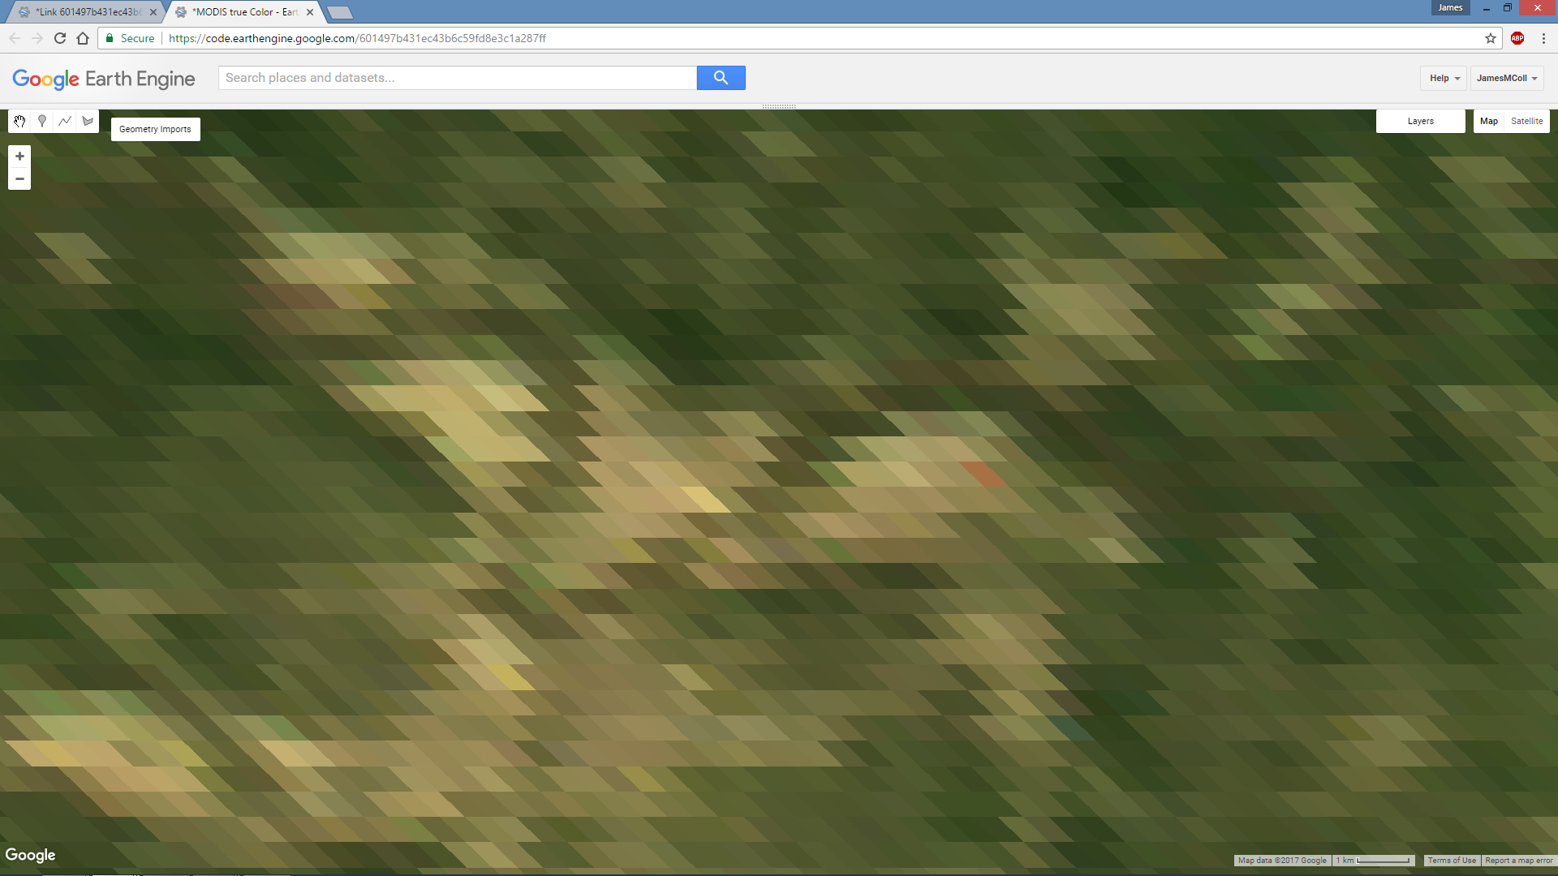
Spatial Resolution

Slide 32
Resolution Concepts: Temporal

Slide 33
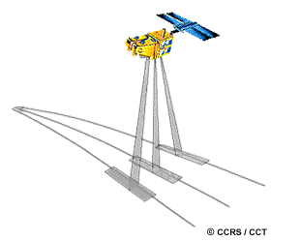
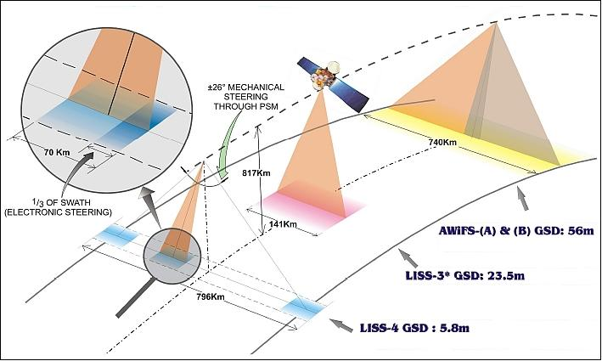
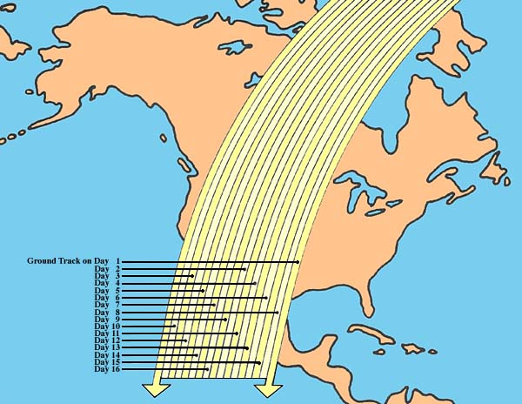
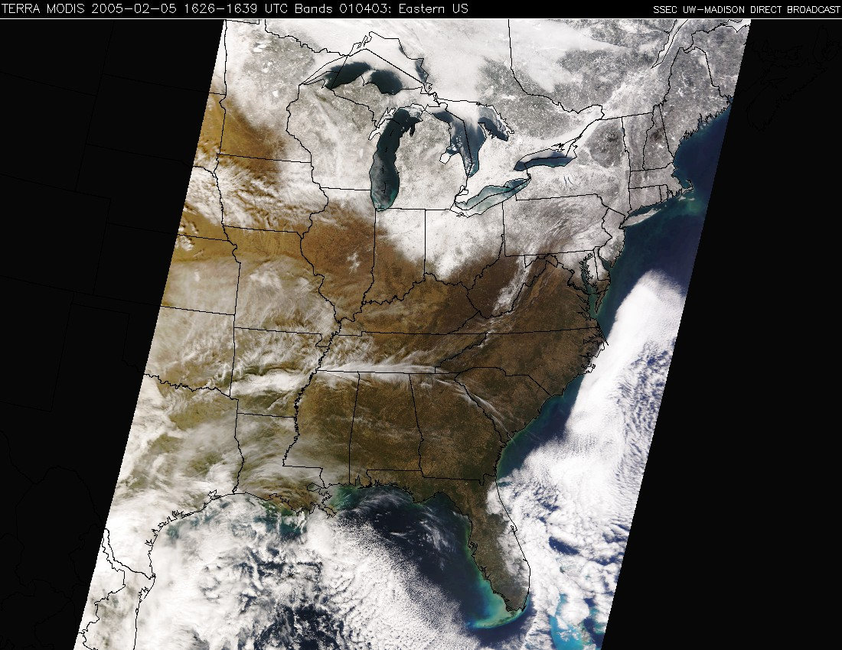
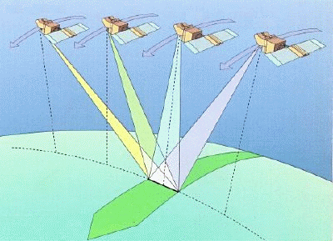
Swath Comparison

Slide 34


Time of Day
Most sensors acquire their images in mid to late morning (i.e., between around 9:30 and 11:00 a.m.)
A few acquire images in the early afternoon (e.g., 2:00 to 2:30)
Some sensors are able to acquire images at night

Slide 35

Multispectral Layer Stack

